Slide 1
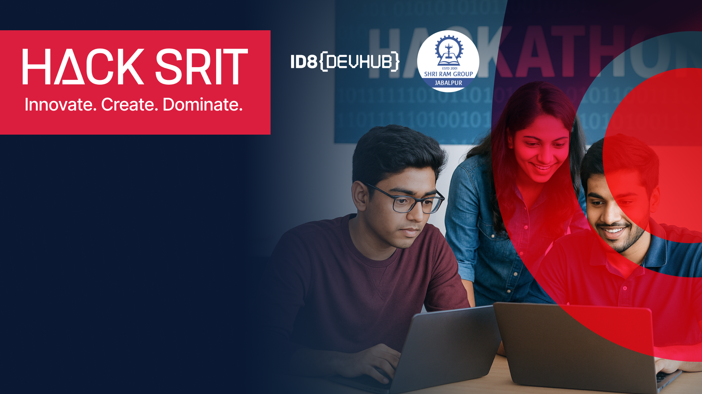
Team Name :
HackGirls (Girl’s Team)
Institute:
Shri Ram Institute of Technology
Contact details for the team lead:
Phone:- 93022 71422
Email:- bp7249951@gmail.com

Slide 2
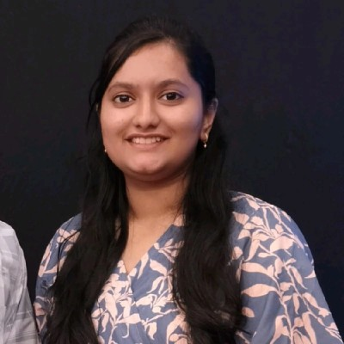
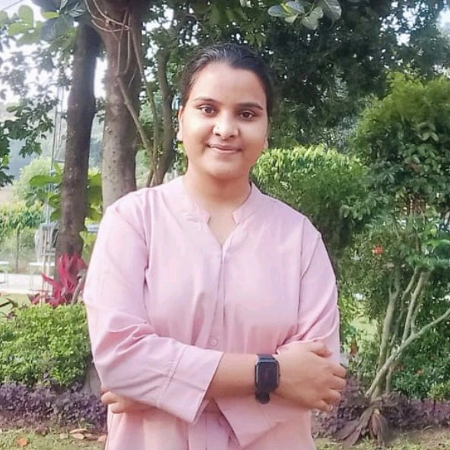

Team HackGirls
Aditi Lakhera
Aditi Soni
Bhumika Patel
Integration of Ayurveda and modern medical science for comprehensive wellness insights

Slide 3
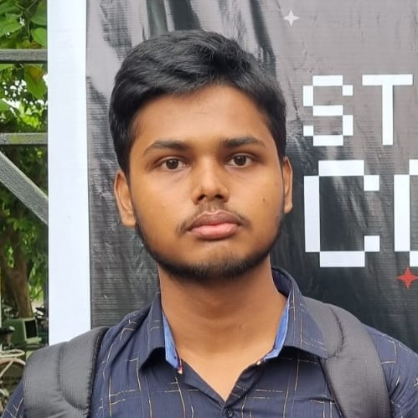
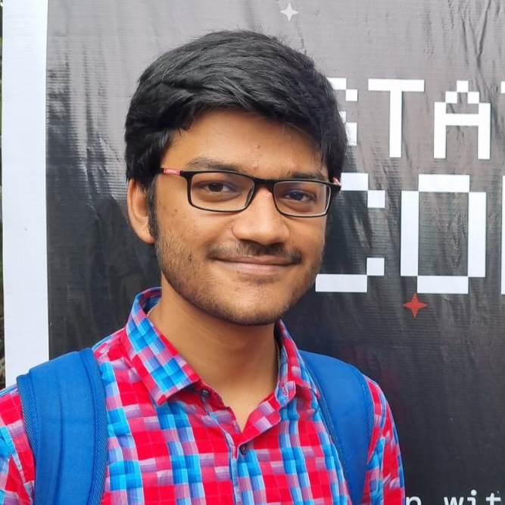
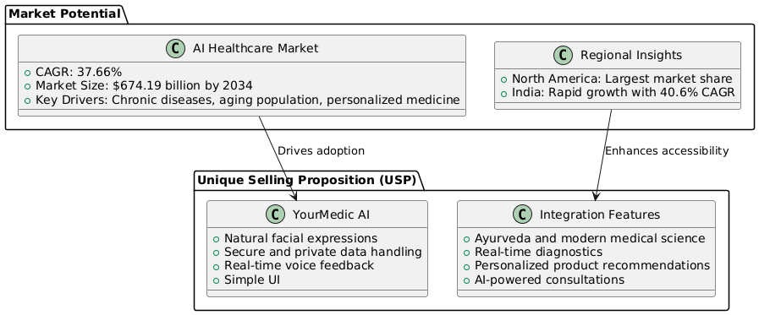

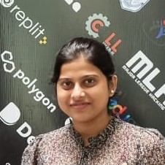
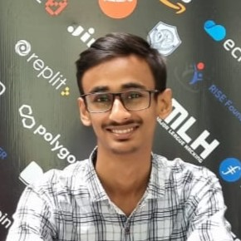
Team Men Of Culture
What is this?
Enhanced diagnostics leveraging OpenAI API and Azure API integration. A user interacts with YourMedic AI to discuss symptoms. The chatbot provides immediate insights and suggests personalized next steps, such as booking a consultation or lifestyle adjustments. integration of Ayurveda (traditional pulse diagnosis) with modern technology, using sensors and real-time data fusion to generate accurate health reports. A wearable sensor tracks user's pulse and vital signs, combining Ayurveda principles with modern analytics. The system generates a real-time health report suggesting dietary changes or supplements based on detected imbalances.

Slide 4
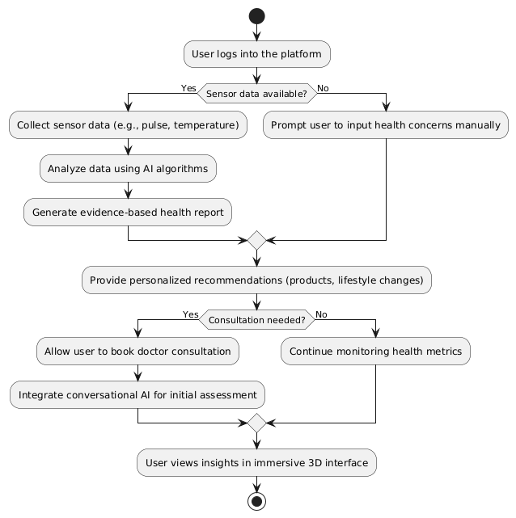
Technologies we used
Three.js
NodeJS
ReactJS
Auth0 authentication
Azure API
OpenAI API
the user interface inspired by Apple’s intuitive design principles, integrated within an interactive 3D environment (XVerse). Example: Users navigate their health data in a visually appealing 3D dashboard, easily accessing insights like sleep patterns, stress levels, or recommended exercises through intuitive gestures and interactions similar to Apple Health.

Slide 5
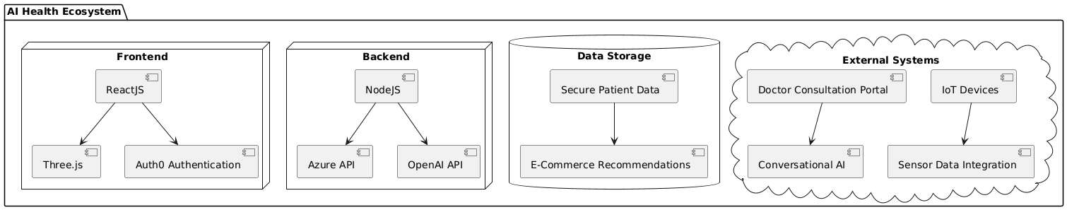
What Makes it unique? Integrated E Commerce and Lifestyle (USP)
Describes AI-driven personalized recommendations for health products, supplements, and lifestyle guidance directly integrated into the app. Based on user's health metrics (e.g., low Vitamin D levels), YourMedic AI automatically recommends suitable supplements available for direct purchase within the app, along with personalized lifestyle advice to improve wellness.

Slide 6
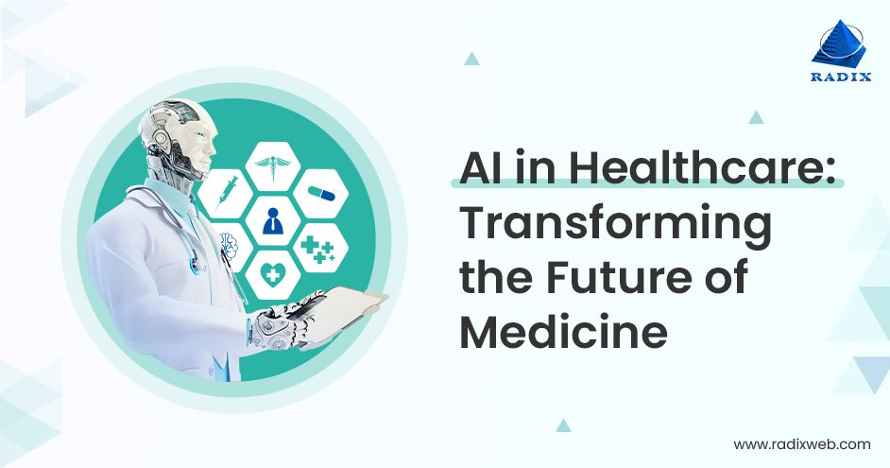
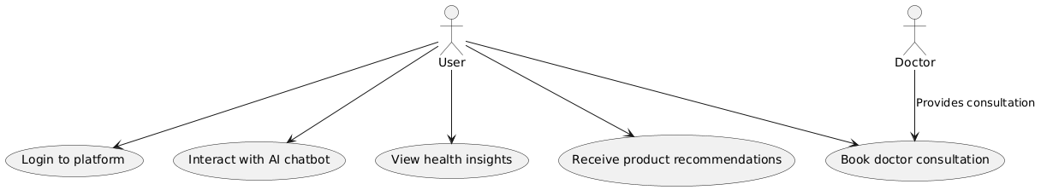
Consultation (AI-Powered Assistance)
Showcases seamless integration of human doctor consultations with conversational AI support that continuously updates insights based on latest medical research. A user experiencing persistent headaches interacts with the chatbot for initial advice. The AI suggests booking a virtual consultation with a neurologist directly within the app. Post-consultation, the chatbot continues providing updated wellness tips based on doctor's prescriptions and latest research findings.

Slide 7
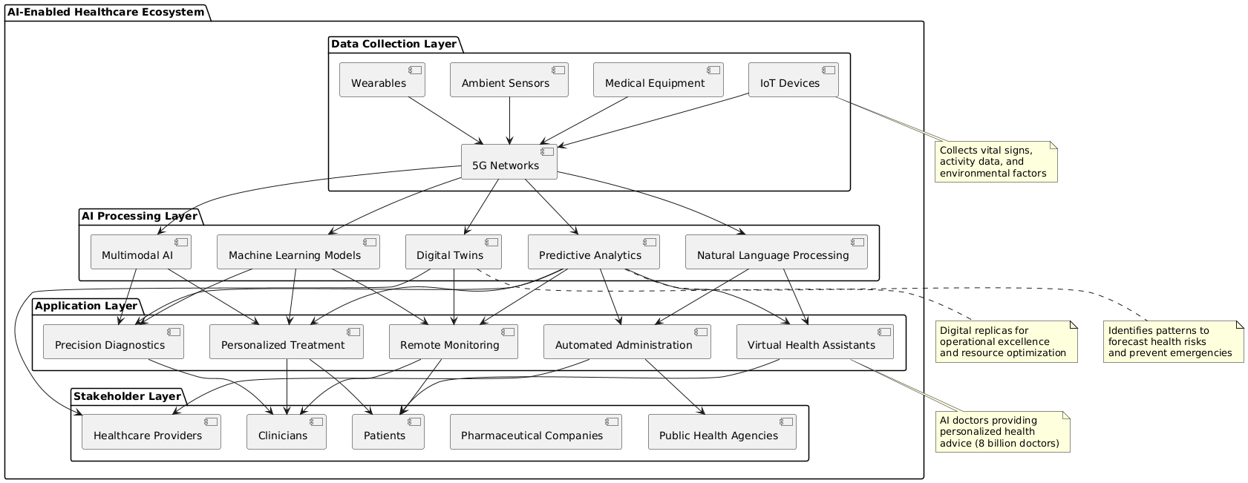
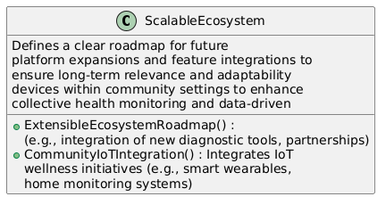
Future Proof Scalable System
Emphasizes the platform's scalability through IoT integration and community-driven features ensuring continuous improvement and adaptability.
Integration of smart home devices (like smart scales or sleep trackers) automatically feeds data into YourMedic AI. The community feature allows users to share wellness journeys, creating a collaborative ecosystem that evolves based on collective experiences and feedback.

Slide 8
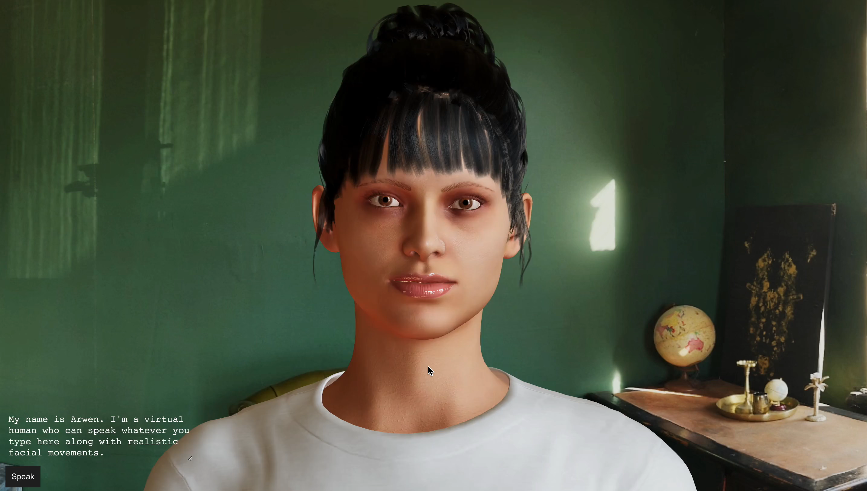
Video Implementation: Run Video
Click on Video

Slide 9

Thank You
AI In Healthcare Market Reasearch

